Slide 1
UH GI Fellowship Program (“UHGI”)
Scott Kuwada, MD, AGAF, FACP
Ken & Gemie Arakawa Endowed Chair and Professor of Medicine, Chief of Gastroenterology, JABSOM, UH
Staff Physician, The Queen’s GI Services and Liver Center

Slide 2
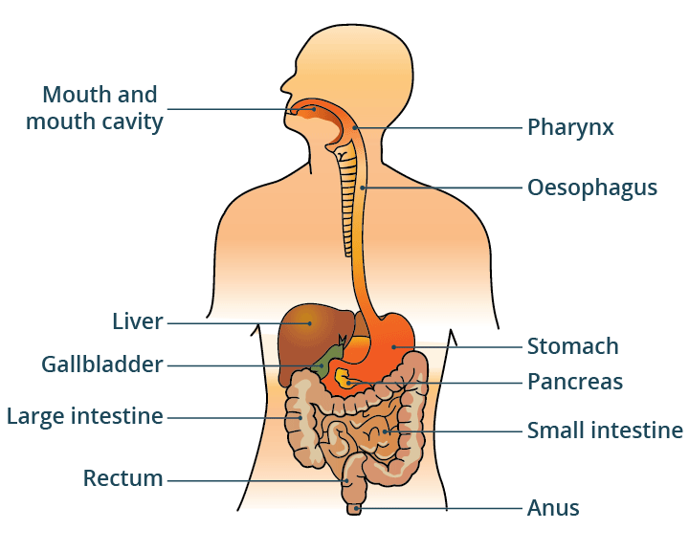
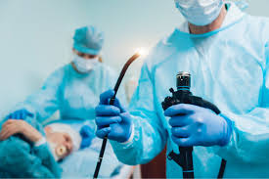
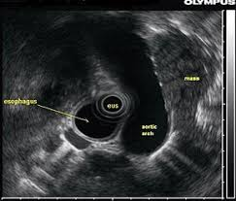
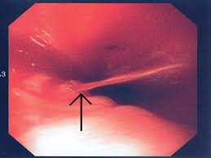
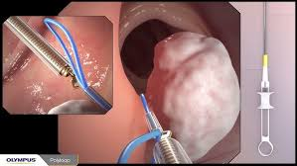
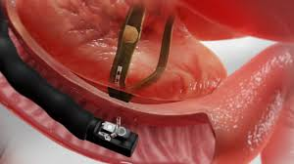
What is needed to train gastroenterologists?
Faculty Expertise & Breadth:
  “lumenologists” – general GI and endoscopists
    EGD, colonoscopy, enteroscopy, pill camera, manometry, esophageal pH & impedance, stents, electrocautery, hemostasis, dilation
  Hepatobiliary – hepatology, transplant hepatology, advanced endoscopy (ERCP, EUS)
  Pancreatologists – medical, endoscopic, surgical management
  GI and Liver Pathologists
  Radiologists
  Oncologists
  Surgeons

Slide 3
GI/Hepatology Fellowship
GI Fellowship:
  3 year ACGME accredited program
  UH = Sponsoring Institution
  QMC = initial training site
  1-3 fellows/yr => 9 fellows
Faculty
  PD = Scott Kuwada, MD (0.3 protected time)
  Min 4 Core Faculty = 4 (0.2 protected time – aggregate)
    APD = Gavin Park, MD
    Transplant Hepatologists= Chuong Tran, MD & Tomoki Sempokuya, MD
    Advanced Endoscopists = Larissa Fujii-Lau, MD & Jaclyn Kagihara, MD
Program Coordinator: Kari Kim

Slide 4
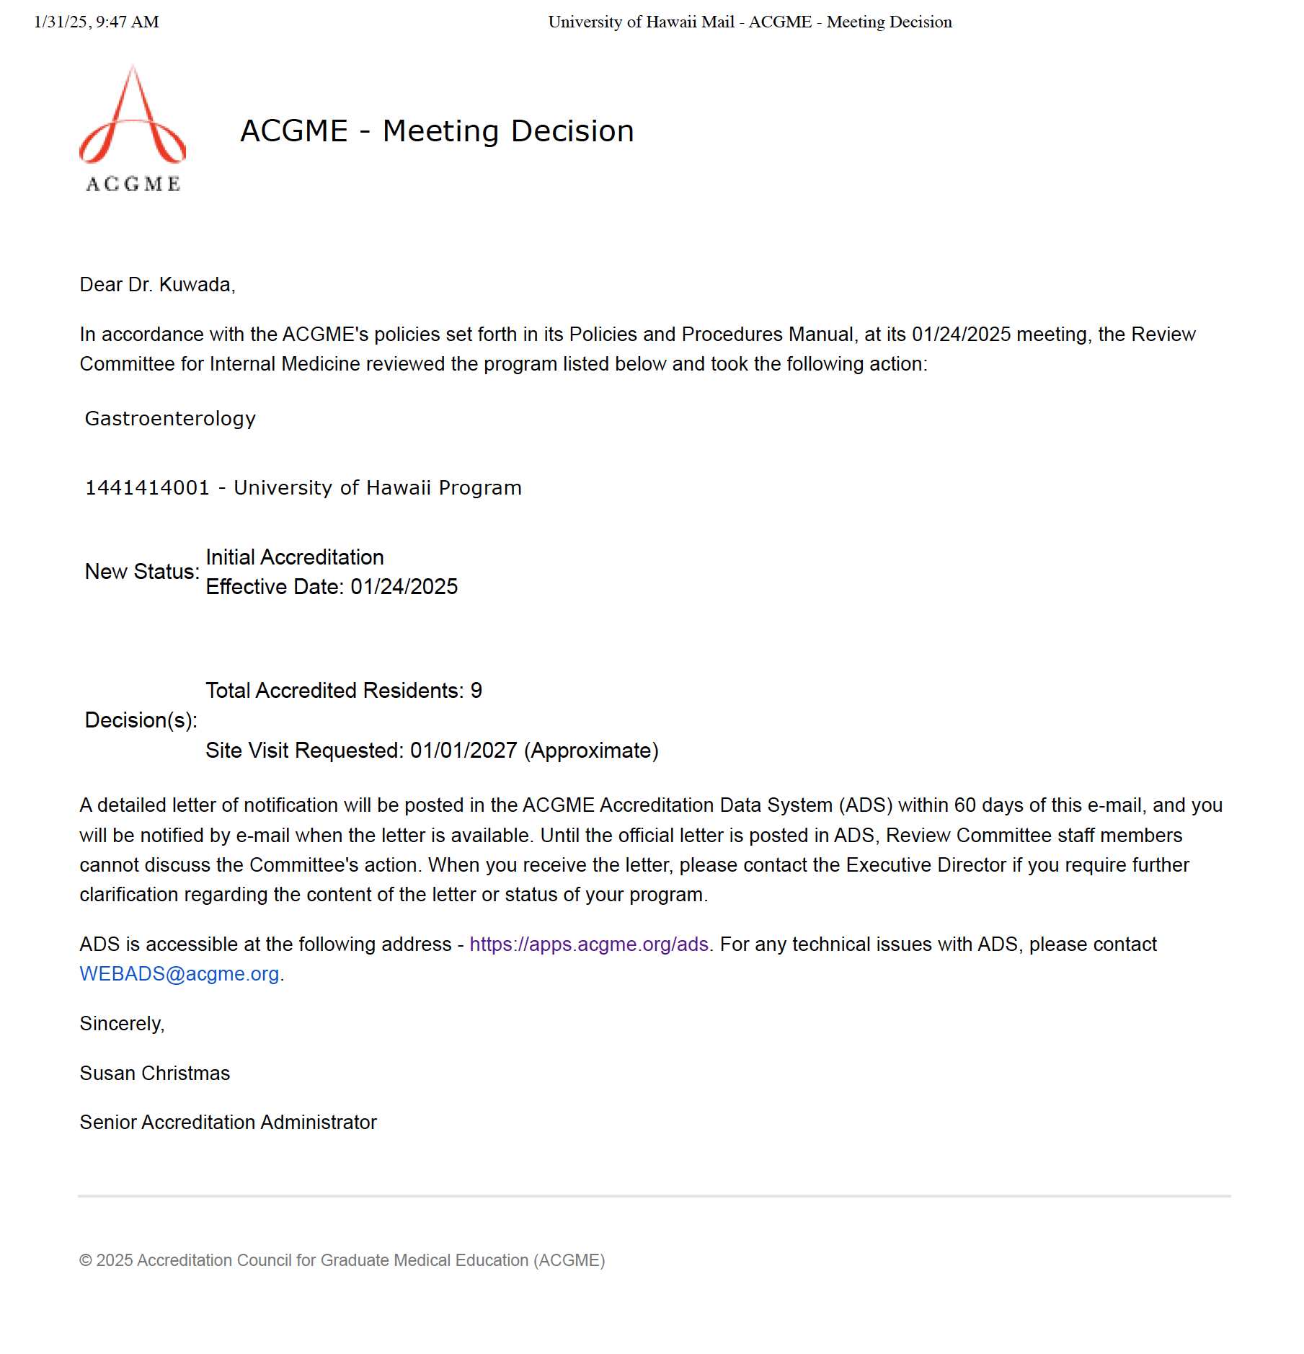

Slide 5
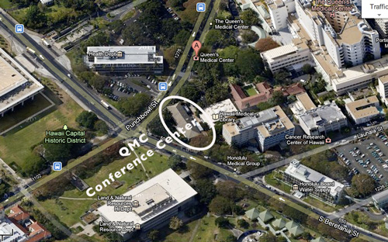
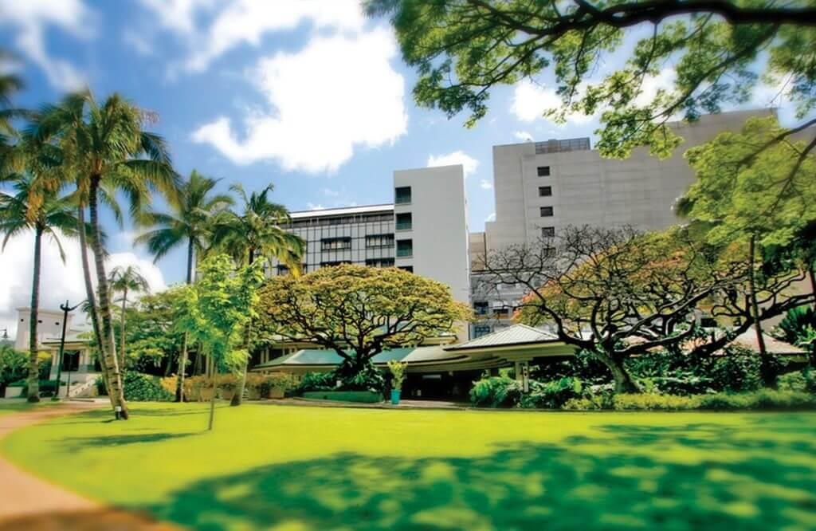
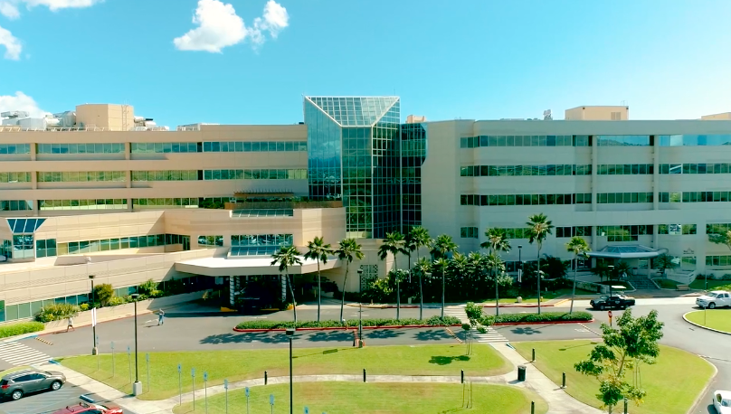
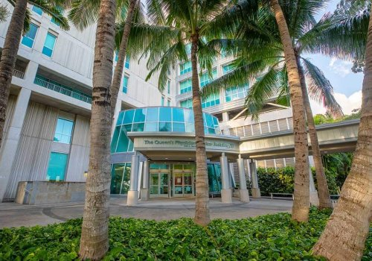
Main Sites
The largest referral center & teaching hospital in Hawaii
  QMC Liver Clinic - 501
  QMC Transplant Center - 401
  QMC GI Services - 501
  QCSP Endoscopy Center – 701
  Kamehameha IV - GI Endoscopy Suite

Slide 6
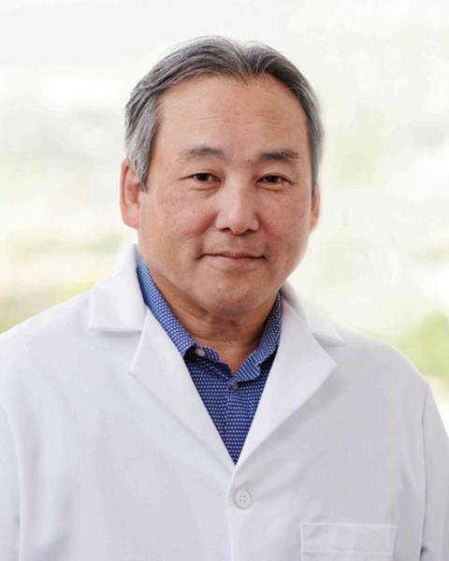
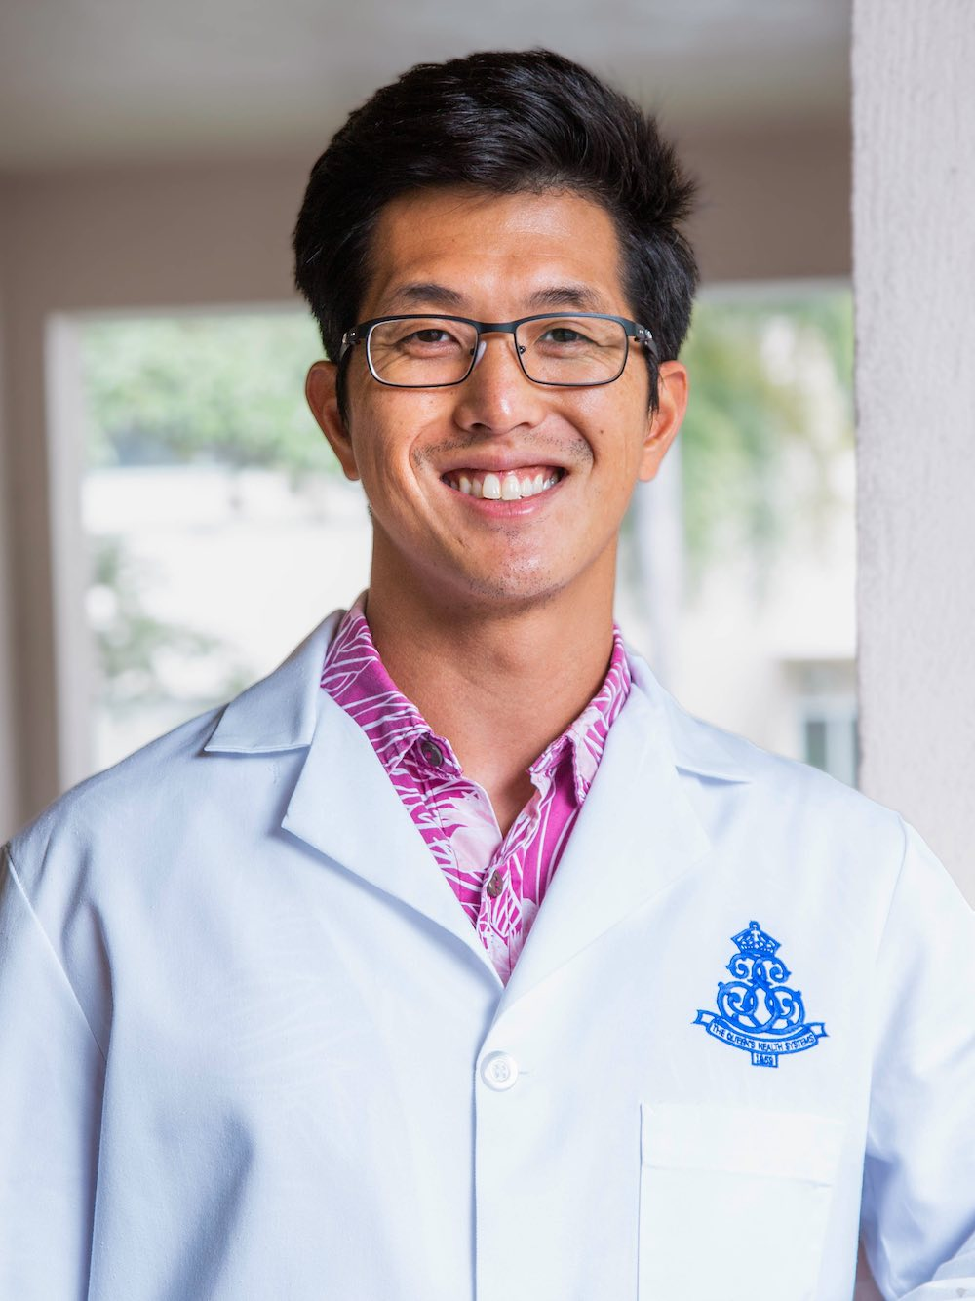
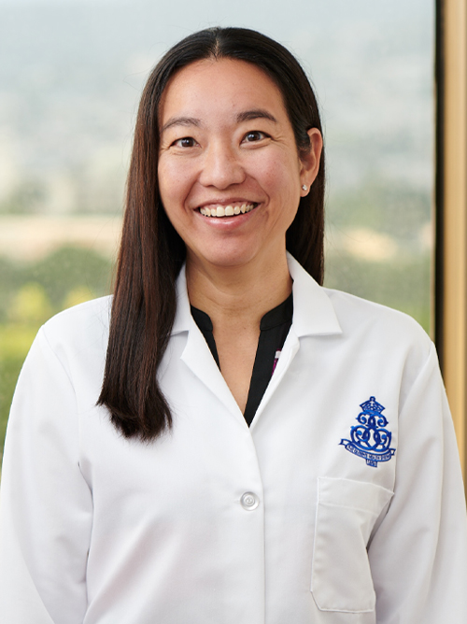
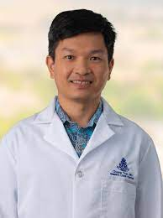
GI Faculty
QHS – Core Faculty
  Scott Kuwada, MD,
  Program Director & Chair of Medicine
  Gavin Park, MD,
  Associate Program Director, Gen GI
  Larissa Fujii-Lau, MD, Advanced Endoscopist
  Chuong Tran, MD, Hepatology/Liver Transplant
  Julia Zhang, MD, Gen GI (starting Jan 2026)
  Teaching Attendings: Dan Chan, MD, Brandon Yim, MD, Kraig Young, MD, Nour Hamade, MD, Christy Ann Gilman, MD, Jaclyn Kagihara, MD
QMC
  Marcia Leung, MD
Straub
  Tim Swindoll, MD & James O’Brien
Kuakini
  Kristi Lopez, MD
Pacific Endoscopy Center
  Robert Wong, MD
Ohana Gastro
  Mel Ona, MD
HMC East
  Ankur Jain, MD & Shilpa Jain, MD

Slide 7
Our liver patients
We are over 2 thousand miles from the nearest liver transplant center.
Most of our patients on the list for liver transplantation do not have the means to travel to and stay near Mainland liver transplant centers when activated. Many also do not have the means to travel to the Mainland for post-transplant care which requires highly specialized centers.

Slide 8
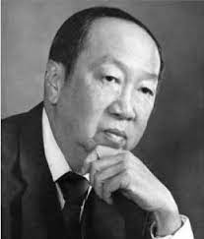
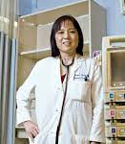
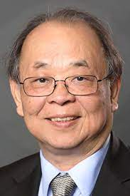
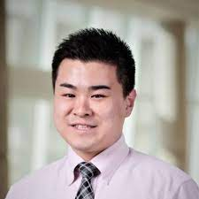
Liver Transplantation & Hepatology
1969 – Dr. Livingston Wong performed the first organ (kidney) transplantation in Hawaii at St. Francis Hospital
1993 – Dr. Linda Wong opened the liver clinic and performed Hawaii’s first liver transplant at St. Francis Hospital
2012 –liver transplant program moved to QMC
2022 – Permanent liver transplant hepatologist was hired by QMC
2023 – Second permanent liver transplant hepatologist was hired by QMC
2023 - > 360 liver transplants (2,250 organ transplants) have been performed in Hawaii
QMC Liver Center is the only dedicated hepatology clinic in Hawaii.

Slide 9
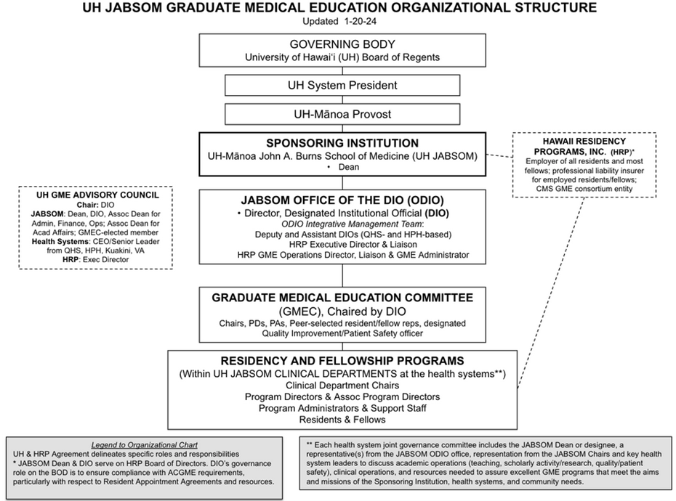

Slide 10
Program Coordinators
Kari Kim – Program Coordinator
Shauna Batad – Admin support
Hawaii Residency Program
  Employer of Residents and Fellows for U of Hawaii Sponsored Training Programs
  Natalie Talamoa, MBA, Exec Dir.
  Patty Carlson, Manager

Slide 11
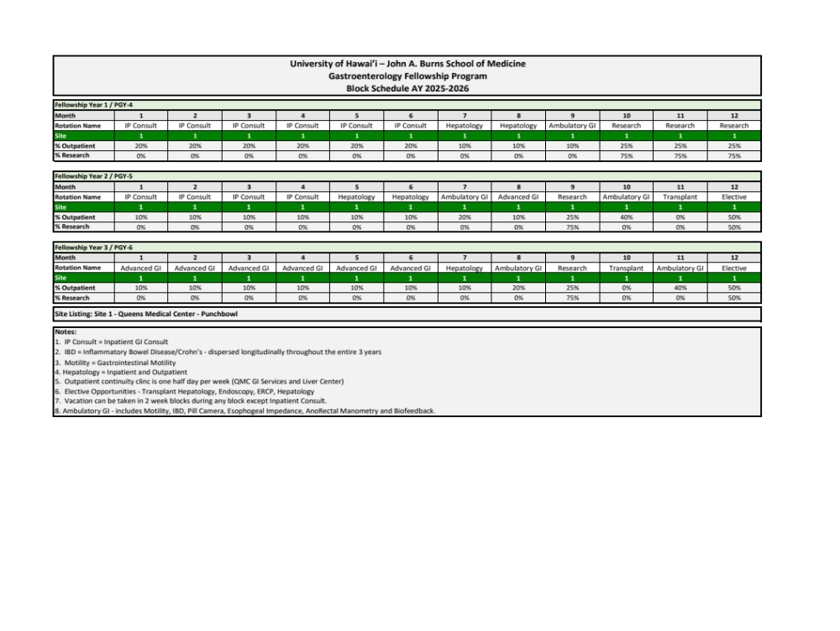
Block Diagram

Slide 12
GI Continuity Clinics
½ day per week X 3 yrs
Other Committees
  Clinical Competency Committee
  Program Evaluation Committee

Slide 13
GI Call, Day-Off Policy, PTO
It is essential training for GI fellows to learn how to deal with GI emergencies.
At-home call is scheduled Q 4 evenings (M-Sa)
24 hours off per week: 0700 Sunday → 0700 Monday
Conference leave = 1 week/year
Vacation = 3 weeks/year

Slide 14
GI Conferences
Weekly Case Conference
  Fellows’ Case Conference
  Pathology
  Radiology
  Critical Appraisal of the Medical Literature
  M&M Conference
Didactic Conferences
  All GI and Liver Topics
Liver Transplant Selection Conf
Hepatobiliary Conf
GI Tumor Boards

Slide 15
Fellow Scholarly Activity
  IV.D.3.a) While in the program all fellows must engage in at least one of the following scholarly activities: participation in grand rounds; posters; workshops; quality improvement presentations; podium presentations; grant leadership; non-peer-reviewed print/electronic resources; articles or publications; book chapters; textbooks; webinars; service on professional committees; or serving as a journal reviewer, journal editorial board member, or editor.
Funds are available to support travel to major GI/Hepatology Conferences to present research.

Slide 16
Other Sites
Oahu
  Hawaii Pacific Health
    Straub Clinic
    Pali Momi Medical Center
  Private Practice GI Electives
Neighbor Islands
  Electives on Maui, Kauai & Big Island (Hawaii Island)

Slide 17
Mahalo!!
skkuwada@Hawaii.edu

